Slide 1
Racial Discrimination from
Hate Speech on Twitter
Arthur Cheong, Andrew Yu, Marco Widodo Group 10
18 August 2023
Final Project Presentation (Milestone #6)
DATASCI 154:
Solving Social Problems With Data

Slide 2
Outline
Framing of the Problem
Our Research Design
Information to Action

Slide 3
Framing the Problem

Slide 4
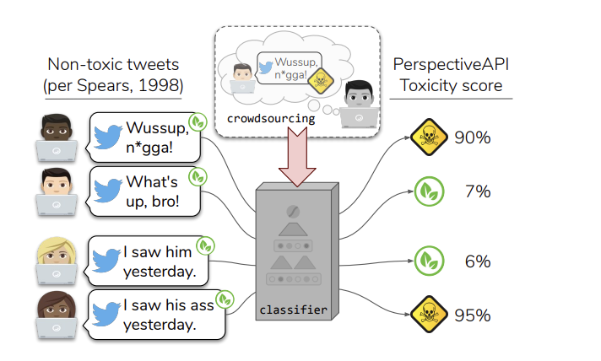
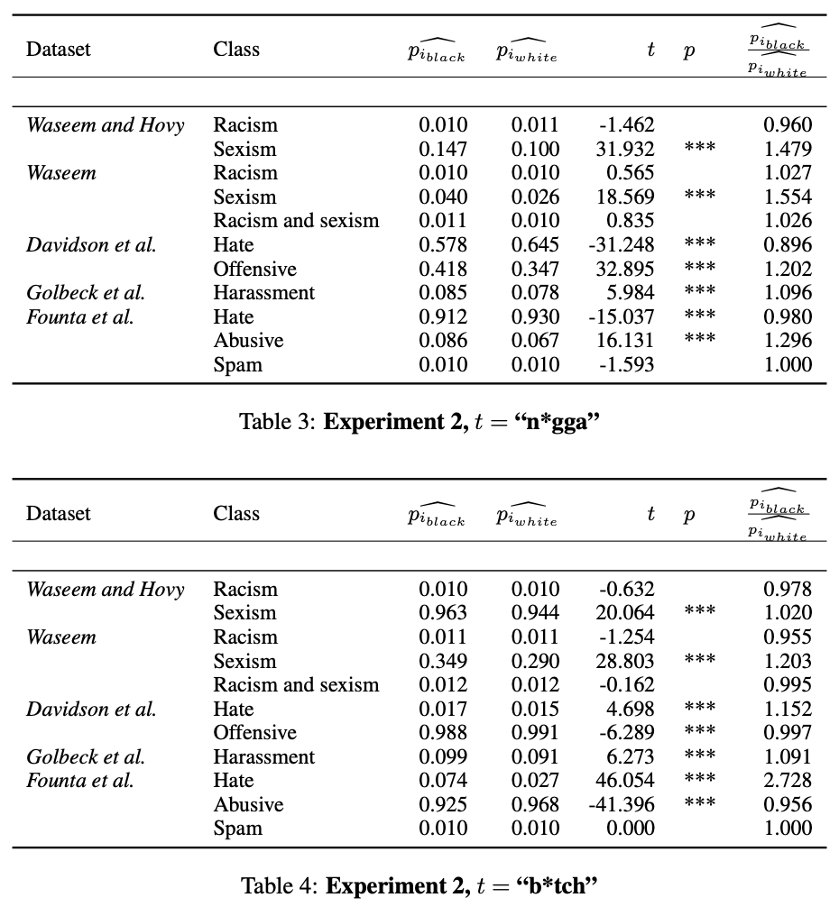
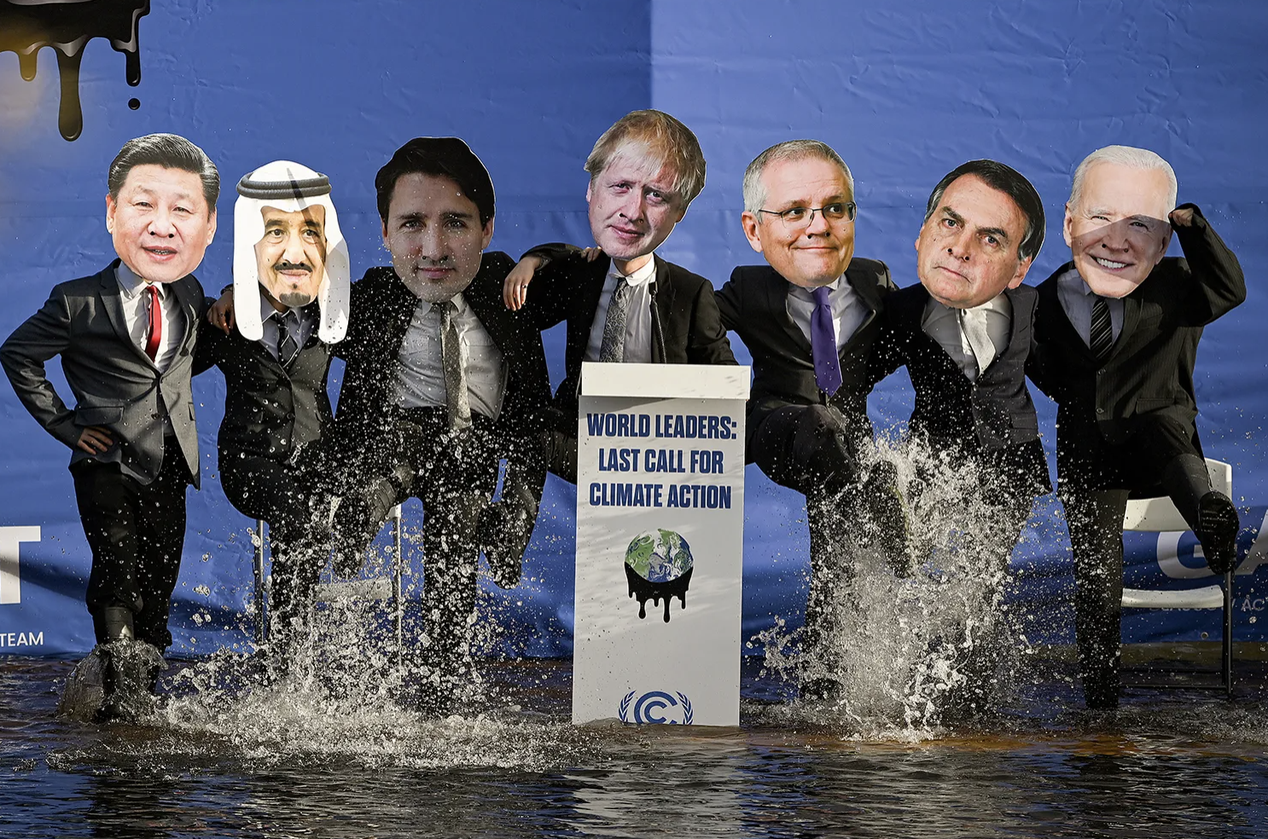
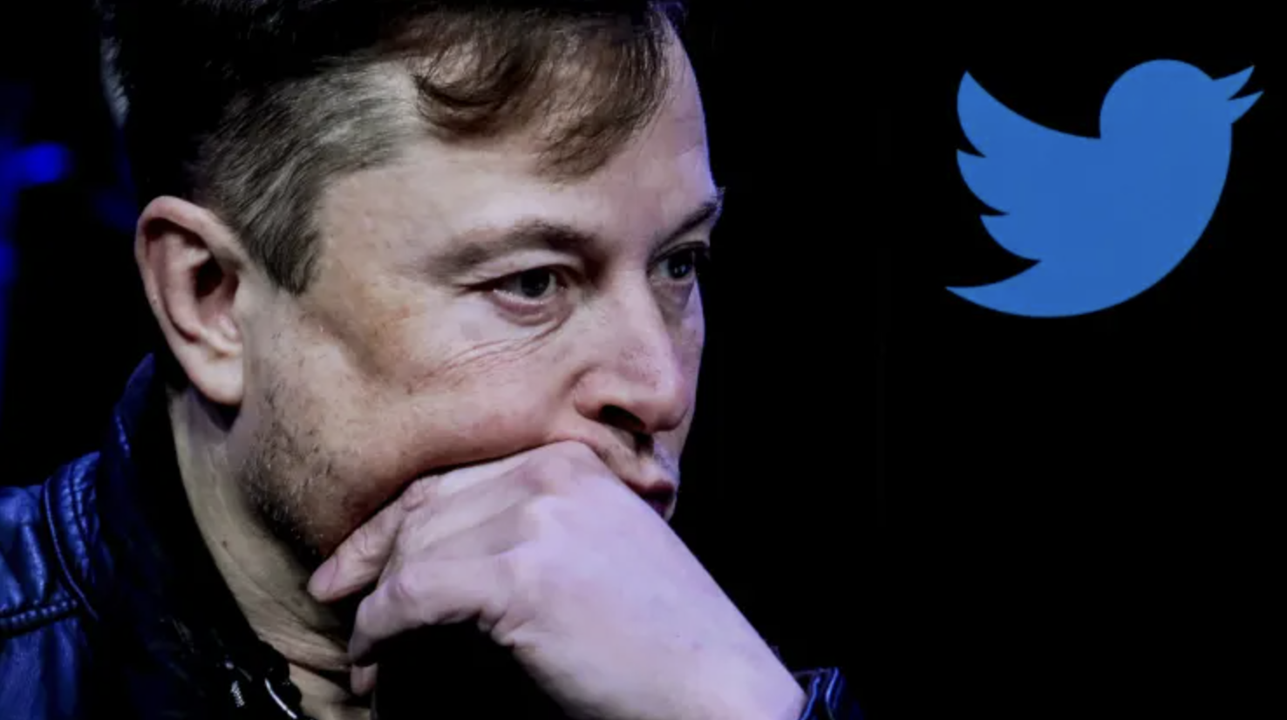
Literature Review
The Risk of Racial Bias in Hate Speech Detection
Racial Bias in Hate Speech and Abusive Language Detection Datasets
Twitter reportedly limits employee access to content moderation tools as midterm election nears
Maarten Sap, et al. (2019)
Thomas Davidson, et al. (2019)
Jonathan Vanian, CNBC

Slide 5



The Problem - Two Sides of the Same Coin
Too much automation
= Discrimination
(2018)
Not enough automation
= Discrimination
(Status Quo)
Notes:
Social media companies like Twitter currently use a mix of both human elements and machine-learning elements in designing their hate speech moderation systems.
The recent transition towards incorporating machine-learning elements was likely motivated by a problem of inefficiency; machine-learning algorithms can scan through large amounts of content in search for “hate speech” a lot quicker than humans are able to.
Studies have shown that machine-learning hate speech detection algorithms often flag the content of certain ethnic groups disproportionately more than others as a result of racially-biased training data. If Twitter used only machine-learning, minorities could face indirect discrimination as the algorithm flags their everyday jargon as “hate speech”.
There exists then an inherent trade-off in deciding how much of each should be involved in the process; more human input generally means more accurate judgements but with slower processing capabilities, while more machine-learning involvement means faster processing capabilities but with less accurate judgements.

Slide 6
Research Question
“How should Twitter balance Machine Learning with Human Input in their hate speech detection framework to minimize racial discrimination against minority users on their platform?”

Slide 7
Research Design

Slide 8
Objective Decision Variables
Objective
Minimize the amount of racial discrimination faced by minority users on Twitter
Decision Variables
Degree of human input (HI)
Degree of machine-learning (ML) involvement
Notes:
Objective in our research design is to minimize the amount of racial discrimination faced by minority users on Twitter.
Decision Variables in our research design include the degree of human input (we call HI) and Degree of machine learning involvement (we call ML)
We will illustrate our variables in a few slides.

Slide 9
Equation
find the minimum of:
RD = HI(a) + ML(b)
where…
RD = Racial Discrimination
HI = degree of Human Input
ML = degree of Machine Learning involvement
a = unknown constant that represents how much human input contributes to racial discrimination
b = unknown constant that represents how much machine learning involvement contributes to racial discrimination
Notes:
first, we will talk about our mathematical model for our research design.
We have a mathematical model for Racial Discrimination, we will call RD
We establish that HI and ML summed together is RD
Inside, we have an “a” and “b” for HI and ML respectively. These represent unknown constants which represent how much their respective areas contribute to racial discrimination.
1 way we can measure constants a & b is by setting ML & HI to 0 respectively
We are trying to minimize this equation of RI.

Slide 10
Decision Variables: Design Illustrated
Less Time
Less Human Input
Fully Machine-Learning Moderation
Added Human Input (Machine Learning + User Reports)
Added Human Output (Machine Learning + Human Moderators)
Added Human Input & Output (Machine Learning + User Reports + Human Moderation)
Fully Human Content Moderation
More Time
More Human Input
Notes:
Here is our design illustrated.
*explain graph, no need script here*

Slide 11
Finding Constants “a” and “b”
No Moderation
RD= HI(a) + ML(b)
Fully Machine-Learning Moderation
RD_{ML}= (0)(a) + ML(b)
RD_{ML} = ML(b)
b = RD_{ML}
Fully Human Content Moderation
RD_{HI}= (HI)(a) + 0(b)
RD_{HI} = HI(a)
a = RD_{HI}
Notes:
One thing you may be asking yourself is how would one find “a” and “b”?
As we can see here, we can use our model to model out the 2 situations that’ll allow us to find a & b.
We could have full machine-learning moderation, where HI is 0 and ML is 1, allowing us to find b
Conversely, full human content moderation, where ML is 0 and HI is 1, allows us to find a.

Slide 12
How Will We Measure Variables?
Objective Variable (Racial Discrimination)
We plan to launch an anonymous survey on the Twitter platform that asks three questions:
“What Race/Ethnicity Do You Identify As?”
“On a scale of 1-10, to what extent do you feel you have been discriminated against by other users on Twitter?”
“On a scale of 1-10, to what extent do you feel you have been discriminated against by Twitter’s content moderation policies?”
By averaging the scores of questions 2 and 3 and grouping responses by their answers to question 1, we can get a rough measure for how much racial discrimination is felt by each minority group.
Decision Variables (HI and ML Involvement)
Measuring the balance of human input and machine learning involvement is difficult to quantify in neat numbers because they work together to function as one larger system
It is not the case that a set portion of tweets get sorted by human moderators while the rest get sorted by machine learning (e.g. 30% human, 70% machine-learning)
Thus, we will largely measure these decision variables on a spectrum ranging from more human input to more machine-learning involvement as previously detailed in the “Decision Variables: Design Illustrated” slide
This spectrum will act as its own metric for measuring the balance of the decision variables as a whole, ranging from 1 (fully machine learning) to 5 (fully human moderation)
Notes:
Objective Variable (Racial Discrimination)
The level of racial discrimination that is produced is also difficult to measure because there exists no reliable metric to quantify a value so subjective. Instead of seeing this as an obstacle, we choose to see this as an opportunity to involve our primary stakeholder in the process; We plan to…
Launch anonymous survey
Ask question about race: “What race / ethnicity you identify as
Scale 1-10 (ask the 2 other ones)
We average the 2 & 3 answers. Why?
Well b/c by averaging and grouping responses, a rough measure is made for how much discrimination by each minority group
Decision Variables (HI and ML involvement)
Difficult bc the two work together as one function as one larger system
Ain’t true that set portion of tweets get sorted by human mods and others by ML
Therefore we measure these vars on spectrum from more human to less (ML) involvement, hence our diagram
Spectrum it own metric for measure balance as whole (1-5) 5 = human

Slide 13
Constraints
Minimum Efficiency Rate
Equation:
T_{UP} ≥ (T_{HI} + T_{ML})
The average time it takes for tweets to be uploaded should be more than or equal to the average collective time necessary for a tweet to be processed by the system
Availability of Human Moderators
Equation:
0 ≤ P_{HCM} ≤ P_{E}
The number of people working as human content moderators is necessarily less than or equal to the total number of employees at Twitter. The number of people working as human content moderators also has to be greater than 0 because you can’t have a negative amount of human content moderators.
(Note: HI = P_{UR} + P_{HCM} → the entire human input factor is made up of user reports and human content moderators; the only constraint is with the human content moderators)
Notes:
Unfortunately, we have some constraints in our model.
Among them are minimum efficiency rate, human moderator availability:
Minimum efficiency rate

Slide 14

Some Ethical Considerations
HCMs’ Exposure to Harmful Content
Human Input Bias

Slide 15
From Information
To Action

Slide 16

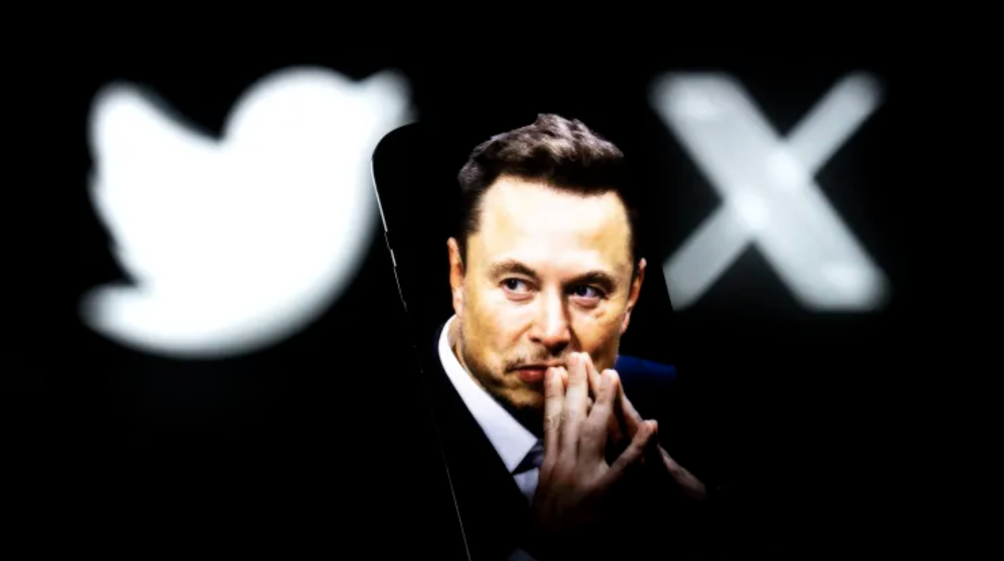
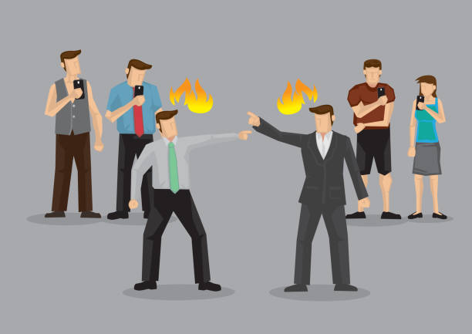
Three Main Obstacles/Oppositions
(1) Lack of Public Awareness
(2) Top-Down Decisions
(3) Behavioral Inaction
How can we tackle these problems?

Slide 17
Involving Stakeholders (e.g. Minority Groups)
User Surveys:
Surveys conducted as part of our research design can allow users to reflect on how much they experience discrimination and from whom they experience it
Answering a question would reveal statistics of how many others responded similarly, based on most recent Department of Justice (DOJ) data, Anti-Defamation League (ADL) annual surveys or within that survey itself
This raises awareness about discrimination on social media
More public awareness about a problem = more public pressure for change to occur
Tackles Public Lack of Awareness &
Tackles Top-Down Decisions
Mandatory Modules:
Many Twitter users rarely think to report discriminatory or otherwise harmful/hateful content
We can implement short, mandatory modules for both new and current Twitter users to teach them how to report specific posts or accounts
This lightens the aforementioned constraint as human input is supplemented to greater extents by Twitter users rather than being predominantly run by HCMs
Tackles Public Inaction
Notes:
(Mandatory Modules) of course the quality may not be as good, but we can implement a certain threshold of valid reports before that tweet gets screened by a HCM

Slide 18
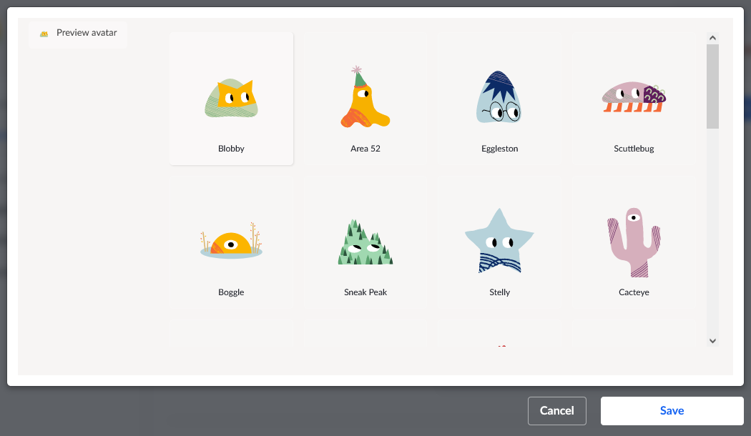
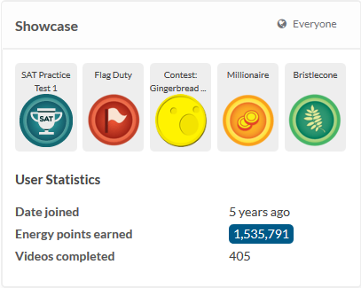
Virtual
Incentive Program
Pros:
easy to implement
non-intrusive
not costly
Cons:
does it attract a certain demographic?
how would we leverage Twitter’s existing Misuse of Reporting Features policy to mitigate fake reports?
Tackles Behavioral Problem… kinda?

Slide 19
Thank You

